Slide 1
UNIT – 2 DESIGN CONCEPT
Komal Singh
Reference Book:
Software Engineering -A Practitioner’s Approach (Seventh Edition) - Roger S. Pressman.
(Chapter 8,9,12 )

Slide 2
Introduction
Mitch Kapor, the creator of Lotus 1-2-3, presented a “software design manifesto” in Dr. Dobbs Journal. He said:
Good software design should exhibit:
Firmness: A program should not have any bugs that inhibit its function.
Commodity: A program should be suitable for the purposes for which it was intended.
Delight: The experience of using the program should be pleasurable one.

Slide 3
What is it?
Design is what almost every engineer wants to do.
It is the place where creativity rules—where stakeholder requirements, business needs, and technical considerations all come together in the formulation of a product or system.
Design creates a representation or model of the software, but unlike the requirements model (that focuses on describing required data, function, and behavior), the design model provides detail about software architecture, data structures, interfaces, and components that are necessary to implement the system.

Slide 4
Who does it?
Software engineers conduct each of the design tasks.
Why is it important?
Design allows you to model the system or product that is to be built.
This model can be assessed for quality and improved before code is generated, tests are conducted, and end users become involved in large numbers. Design is the place where soft- ware quality is established.

Slide 5
What are the steps?
Design depicts the software in a number of different ways. First, the architecture of the system or product must be represented. Then, the interfaces that connect the software to end users, to other systems and devices, and to its own constituent components are modeled.
Finally, the software components that are used to construct the system are designed.
Each of these views represents a different design action, but all must conform to a set of basic design concepts that guide software design work.

Slide 6
What is the work product?
A design model that encompasses architectural, interface, component- level, and deployment representations is the primary work product that is produced during software design.

Slide 7
Design within the concept of software Engineering
“The most common miracle of software engineering is the transition from analysis to design and design to code.”
Software design sits at the technical kernel of software engineering and is applied regardless of the software process model that is used.
Beginning once software requirements have been analyzed and modeled, software design is the last software engineering action within the modeling activity and sets the stage for construction (code generation and testing).

Slide 8
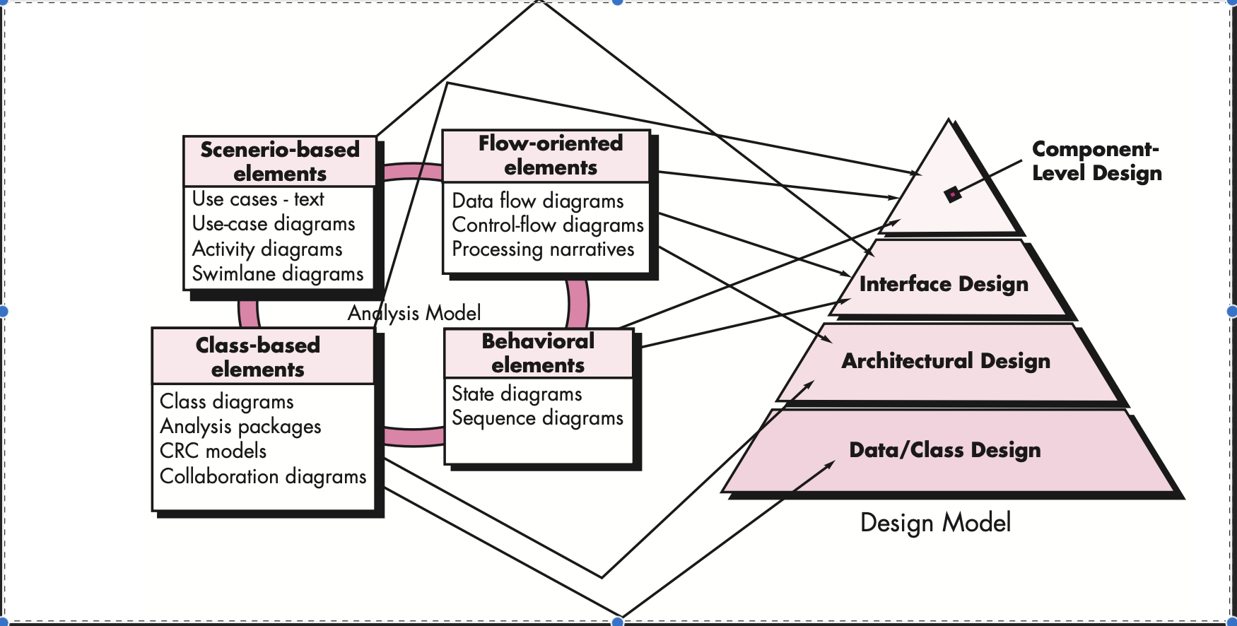
Dsign model

Slide 9
Cont...
Each of the elements of the requirements model provides in- formation that is necessary to create the four design models required for a complete specification of design.
The flow of information during software design is illustrated in Figure.
The data/class design :
Transforms class models into design class realizations and the requisite data structures required to implement the software.
The objects and relationships defined in the CRC diagram and the detailed data content depicted by class attributes and other notation provide the basis for the data design action. Part of class design may occur in conjunction with the design of software architecture. More detailed class design occurs as each software component is designed.

Slide 10
Cont...
The architectural design :
Defines the relationship between major structural elements of the software, the architectural styles and design patterns that can be used to achieve the requirements defined for the system, and the constraints that affect the way in which architecture can be implemented.
The architectural design representation the framework of a computer-based system is derived from the requirements model.

Slide 11
Cont...
The interface design:
describes how the software communicates with systems that interoperate with it, and with humans who use it. An interface implies a flow of information (e.g., data and/or control) and a specific type of behavior.
Therefore, usage scenarios and behavioral models provide much of the information required for interface design.
The component-level :design transforms structural elements of the software architecture into a procedural description of software components. Information obtained from the class-based models, flow models, and behavioral models serve as the basis for component design.

Slide 12
Cont...
The importance of software design can be stated with a single word quality.
Design is the place where quality is fostered in software engineering.
Design provides you with representations of software that can be assessed for quality.
Design is the only way that you can accurately translate stakeholder’s requirements into a finished software product or system.
Software design serves as the foundation for all the soft- ware engineering and software support activities that follow.

Slide 13
Quick note of Design Model
Data/Class design – transforms analysis classes into implementation classes and data structures
Architectural design – defines relationships among the major software structural elements.
Interface design – defines how software elements, hardware elements, and end-users communicate.
Component-level design – transforms structural elements into procedural descriptions of software components

Slide 14
The Design Process
Software design is an iterative process through which requirements are translated into a “blueprint” for constructing the software.
Initially, the blueprint depicts a holistic view of software. That is, the design is represented at a high level of abstraction— a level that can be directly traced to the specific system objective and more detailed data, functional, and behavioral requirements.
The design must implement all of the explicit requirements contained in the analysis model, and it must accommodate all of the implicit requirements desired by the customer.
The design must be a readable, understandable guide for those who generate code and for those who test and subsequently support the software.
The design should provide a complete picture of the software, addressing the data, functional, and behavioral domains from an implementation perspective.

Slide 15
Quality Guidelines
A design should exhibit an architecture that (1) has been created using recognizable architectural styles or patterns, (2) is composed of components that exhibit good design characteristics and (3) can be implemented in an evolutionary fashion.
A design should be modular that is, the software should be logically partitioned into elements or subsystems.
A design should contain distinct representations of data, architecture, interfaces, and components.
A design should lead to data structures that are appropriate for the classes to be implemented and are drawn from recognizable data patterns.

Slide 16
A design should lead to components that exhibit independent functional characteristics.
A design should lead to interfaces that reduce the complexity of connections between components and with the external environment.
A design should be derived using a repeatable method that is driven by information obtained during software requirements analysis.
A design should be represented using a notation that effectively communicates its meaning.
These design guidelines are not achieved by chance. They are achieved through the application of fundamental design principles, systematic methodology, and thorough review.

Slide 17
Design Principles
The design process should not suffer from ‘tunnel vision.’The design should be traceable to the analysis model.The design should not reinvent the wheel.
The design should “minimize the intellectual distance” [DAV95] between the software and the problem as it exists in the real world.
The design should exhibit uniformity and integration.The design should be structured to accommodate change.The design should be structured to degrade gently, even when aberrant data, events, or operating conditions are encountered.
Design is not coding, coding is not design.The design should be assessed for quality as it is being created, not after the fact.The design should be reviewed to minimize conceptual (semantic) errors.From Davis [DAV95]

Slide 18
Fundamental Concepts of Design Process
Architecture—the overall structure of the software.
Patterns—”conveys the essence” of a proven design solution.
Separation of concerns—any complex problem can be more easily handled if it is subdivided into pieces.
Modularity—compartmentalization of data and function.
Hiding—controlled interfaces.
Functional independence—single-minded function and low coupling.
Refinement—elaboration of detail for all abstractions.

Slide 19
Cont...
Aspects—a mechanism for understanding how global requirements affect design.
Refactoring—a reorganization technique that simplifies the design.
OO design concepts—Appendix II.
Design Classes—provide design detail that will enable analysis classes to be implemented.

Slide 20
Architecture
“The overall structure of the software and the ways in which that structure provides conceptual integrity for a system.” [SHA95a]Structural properties.
This aspect of the architectural design representation defines the components of a system (e.g., modules, objects, filters) and the manner in which those components are packaged and interact with one another.
For example, objects are packaged to encapsulate both data and the processing that manipulates the data and interact via the invocation of methods

Slide 21
Extra-functional properties:
The architectural design description should address how the design architecture achieves requirements for performance, capacity, reliability, security, adaptability, and other system characteristics.
Families of related systems. The architectural design should draw upon repeatable patterns that are commonly encountered in the design of families of similar systems.
In essence, the design should have the ability to reuse architectural building blocks.

Slide 22
Patterns Design Pattern Template
Pattern name—describes the essence of the pattern in a short but expressive name
Intent—describes the pattern and what it does.
Also-known-as—lists any synonyms for the pattern.
Motivation—provides an example of the problem.
Applicability—notes specific design situations in which the pattern is applicable.
Structure—describes the classes that are required to implement the pattern

Slide 23
Participants—describes the responsibilities of the classes that are required to implement the pattern.
Collaborations—describes how the participants collaborate to carry out their responsibilities.
Consequences—describes the “design forces” that affect the pattern and the potential trade-offs that must be considered when the pattern is implemented.
Related patterns—cross-references related design patterns.

Slide 24
Separation of Concerns
Any complex problem can be more easily handled if it is subdivided into pieces that can each be solved and/or optimized independently.
A concern is a feature or behavior that is specified as part of the requirements model for the softwareBy separating concerns into smaller, and therefore more manageable pieces, a problem takes less effort and time to solve.

Slide 25
Modularity
"modularity is the single attribute of software that allows a program to be intellectually manageable" [Mye78].Monolithic software (i.e., a large program composed of a single module) cannot be easily grasped by a software engineer.
The number of control paths, span of reference, number of variables, and overall complexity would make understanding close to impossible.
In almost all instances, you should break the design into many modules, hoping to make understanding easier and as a consequence, reduce the cost required to build the software.

Slide 26
Functional Independence
Functional independence is achieved by developing modules with "single-minded" function and an "aversion" to excessive interaction with other modules.
Cohesion is an indication of the relative functional strength of a module.
A cohesive module performs a single task, requiring little interaction with other components in other parts of a program. Stated simply, a cohesive module should (ideally) do just one thing.
Coupling is an indication of the relative interdependence among modules.
Coupling depends on the interface complexity between modules, the point at which entry or reference is made to a module, and what data pass across the interface.
Note: Need to Read all From chapter No.8 (8.2.1 to 8.3.12)

Slide 27
Software Architecture
What is it?
Architectural design represents the structure of data and program components that are required to build a computer-based system.
It considers the architectural style that the system will take, the structure and properties of the components that constitute the system, and the interrelationships that occur among all architectural components of a system.
Ever since the first program was divided into modules, software systems have had architectures, and programmers have been responsible for the interactions among the modules and the global properties of the assemblage.

Slide 28
Cont...
Historically, architectures have been implicit accidents of implementation, or legacy systems of the past.
Good software developers have often adopted one or several architectural patterns as strategies for system organization, but they use these patterns informally and have no means to make them explicit in the resulting system.

Slide 29
Why is Architecture Important?
Representations of software architecture are an enabler for communication between all parties (stakeholders) interested in the development of a computer-based system.
The architecture highlights early design decisions that will have a profound impact on all software engineering work that follows and, as important, on the ultimate success of the system as an operational entity.
Architecture “constitutes a relatively small, intellectually graspable mode of how the system is structured and how its components work together” [BAS03].

Slide 30
Architectural Descriptions
The IEEE Computer Society has proposed IEEE-Std-1471-2000, Recommended Practice for Architectural Description of Software-Intensive System, [IEE00]
to establish a conceptual framework and vocabulary for use during the design of software architecture,
to provide detailed guidelines for representing an architectural description, and
to encourage sound architectural design practices.
The IEEE Standard defines an architectural description (AD) as a “a collection of products to document an architecture.”
The description itself is represented using multiple views, where each view is “a representation of a whole system from the perspective of a related set of [stakeholder] concerns.”

Slide 31
Architectural Genres
Genre implies a specific category within the overall software domain.
Within each category, you encounter a number of subcategories.
For example, within the genre of buildings, you would encounter the following general styles: houses, condos, apartment buildings, office buildings, industrial building, warehouses, and so on.
Within each general style, more specific styles might apply. Each style would have a structure that can be described using a set of predictable patterns.

Slide 32
Architectural Styles
Each style describes a system category that encompasses: (1) a set of components (e.g., a database, computational modules) that perform a function required by a system, (2) a set of connectors that enable “communication, coordination and cooperation” among components, (3) constraints that define how components can be integrated to form the system, and (4) semantic models that enable a designer to understand the overall properties of a system by analyzing the known properties of its constituent parts.

Slide 33
Data-centered architectures
Data flow architectures
Call and return architectures
Object-oriented architectures
Layered architectures

Slide 34
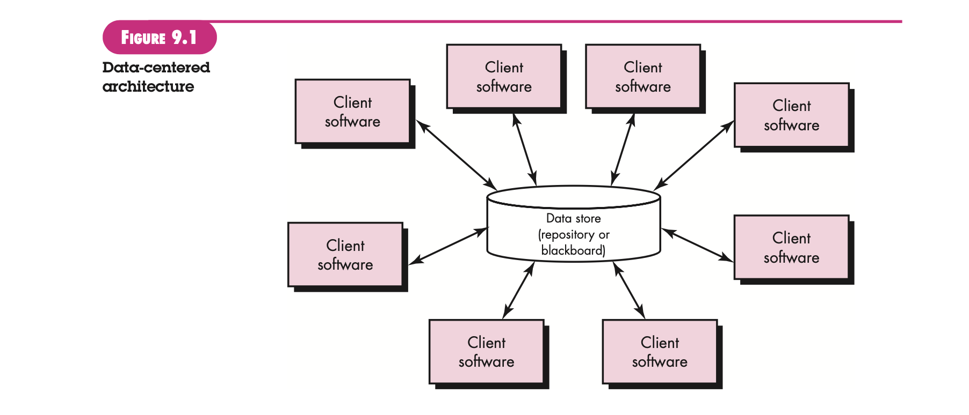
Data-Centered Architecture

Slide 35
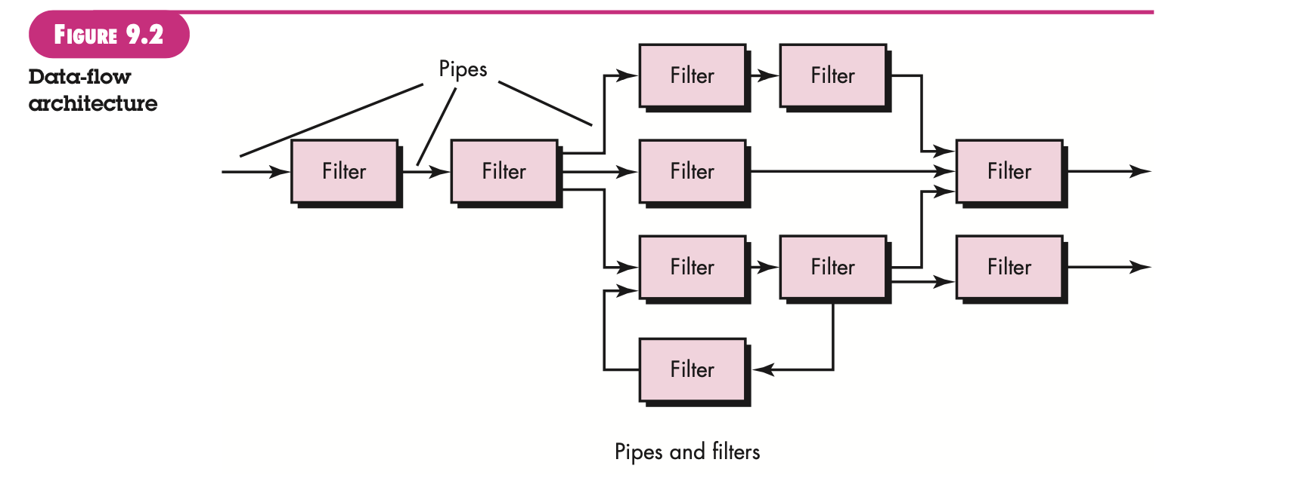
Data Flow Architecture

Slide 36
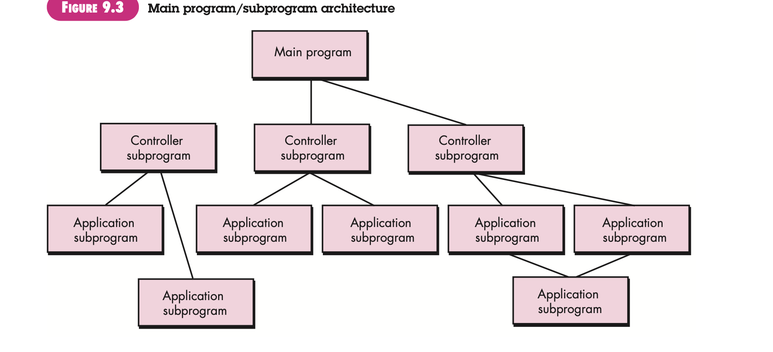
Main Program/Subprogram Architecture

Slide 37
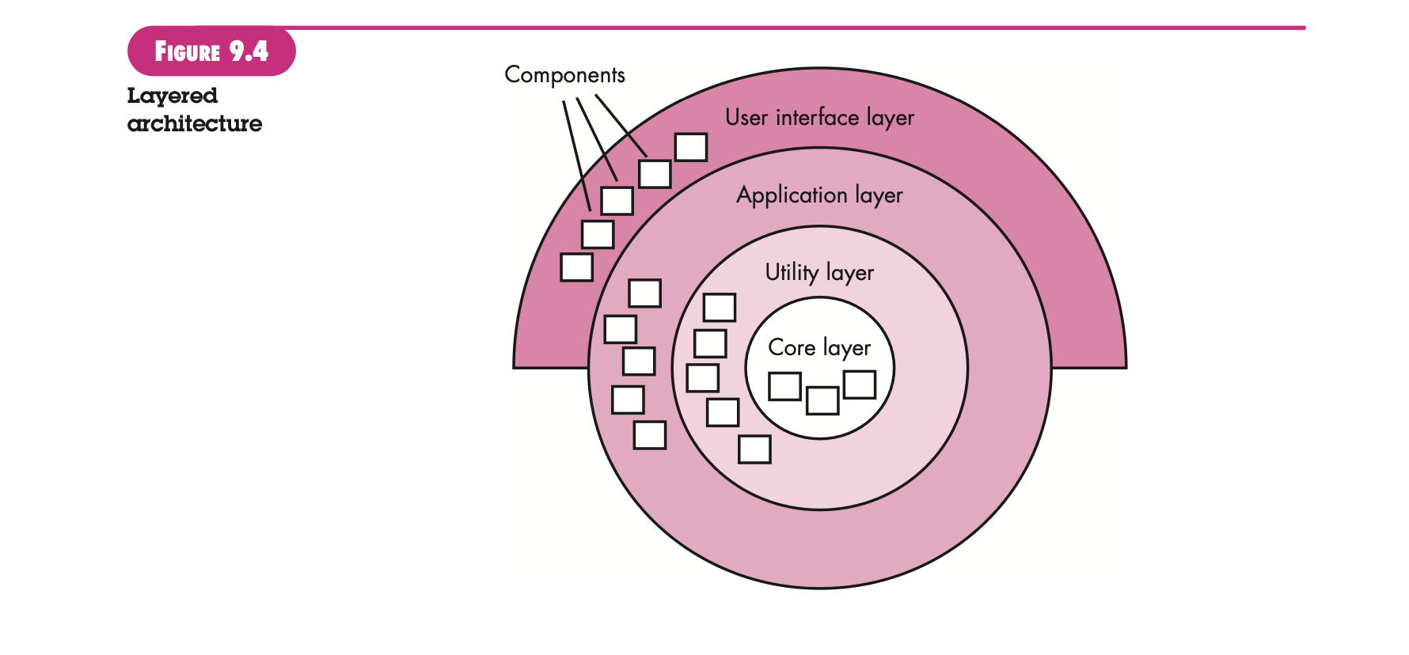
Layered Architecture

Slide 38
Architectural Patterns
Concurrency—applications must handle multiple tasks in a manner that simulates parallelism
operating system process management pattern
task scheduler pattern
Persistence—Data persists if it survives past the execution of the process that created it. Two patterns are common:
a database management system pattern that applies the storage and retrieval capability of a DBMS to the application architecture
an application level persistence pattern that builds persistence features into the application architecture
Distribution— the manner in which systems or components within systems communicate with one another in a distributed environment
A broker acts as a ‘middle-man’ between the client component and a server component.

Slide 39
Architectural Design
The software must be placed into context
the design should define the external entities (other systems, devices, people) that the software interacts with and the nature of the interaction
A set of architectural archetypes should be identified
An archetype is an abstraction (similar to a class) that represents one element of system behavior
The designer specifies the structure of the system by defining and refining software components that implement each archetype

Slide 40
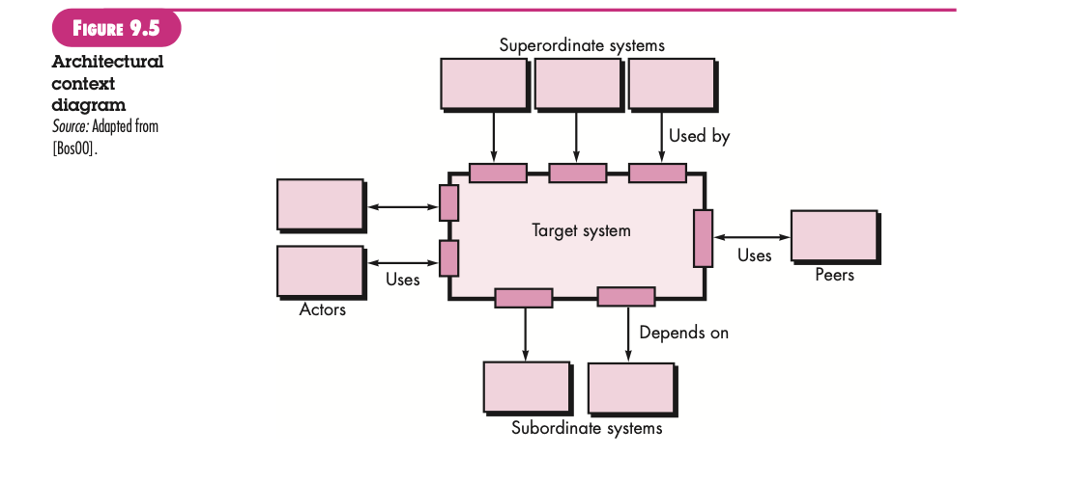
Architectural Context

Slide 41
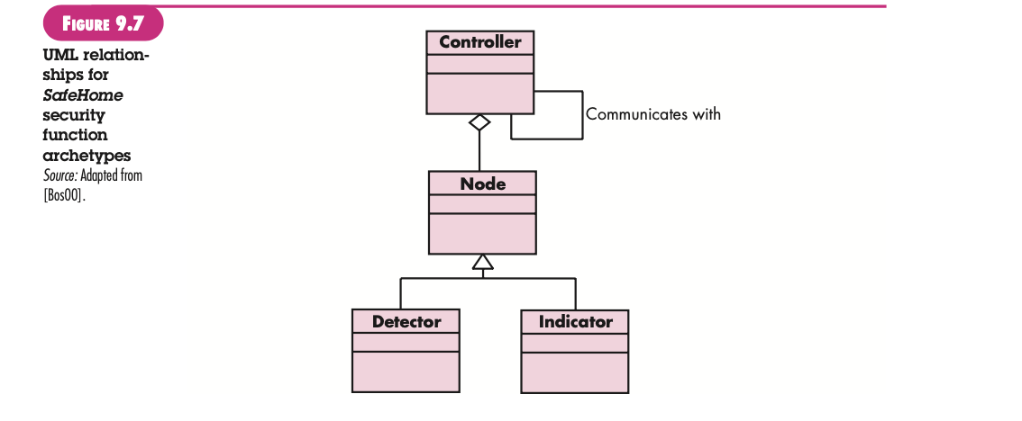
Archetypes

Slide 42
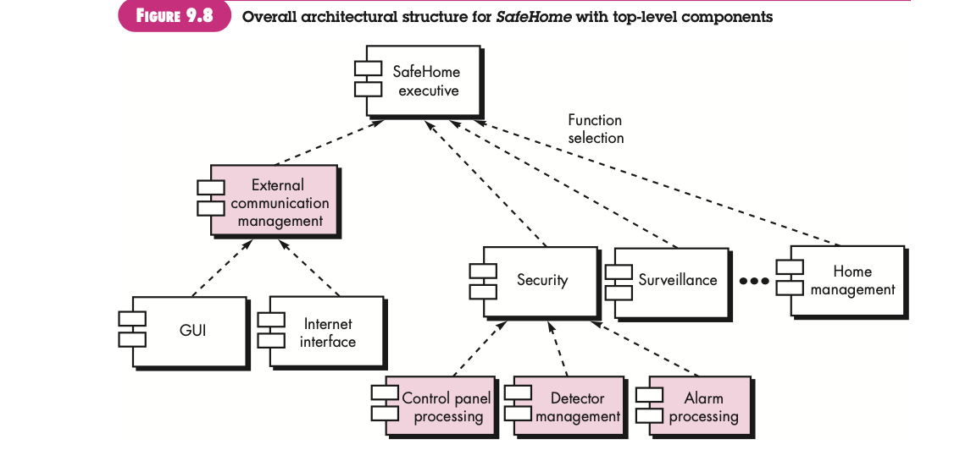
Component Structure

Slide 43
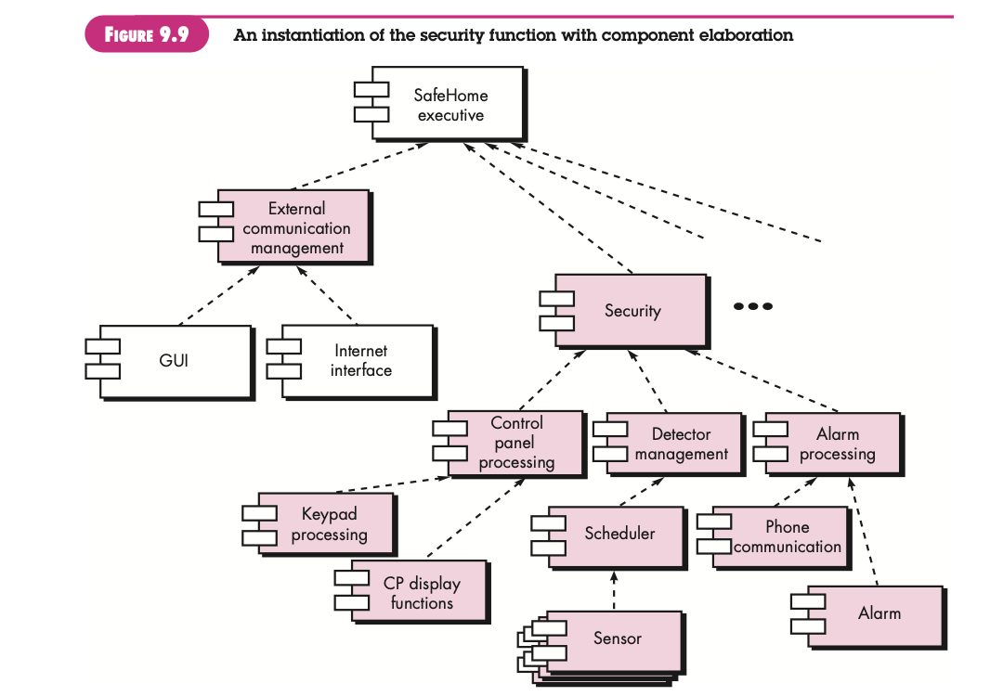
Refined Component Structure

Slide 44
Analyzing Architectural Design
1. Collect scenarios.
2. Elicit requirements, constraints, and environment description.
3. Describe the architectural styles/patterns that have been chosen to address the scenarios and requirements:
• module view
• process view
• data flow view
4. Evaluate quality attributes by considered each attribute in isolation.
5. Identify the sensitivity of quality attributes to various architectural attributes for a specific architectural style.
6. Critique candidate architectures (developed in step 3) using the sensitivity analysis conducted in step 5.

Slide 45
Architectural Complexity
the overall complexity of a proposed architecture is assessed by considering the dependencies between components within the architecture [Zha98]
Sharing dependencies represent dependence relationships among consumers who use the same resource or producers who produce for the same consumers.
Flow dependencies represent dependence relationships between producers and consumers of resources.
Constrained dependencies represent constraints on the relative flow of control among a set of activities.

Slide 46
ADL
Architectural description language (ADL) provides a semantics and syntax for describing a software architecture
Provide the designer with the ability to:
decompose architectural components
compose individual components into larger architectural blocks and
represent interfaces (connection mechanisms) between components.

Slide 47
Design Pattern
A design pattern can be characterized as “a three-part rule which expresses a relation between a certain context, a problem, and a solution” [Ale79].
For software design, context allows the reader to understand the environment in which the problem resides and what solution might be appropriate within that environment.
A set of requirements, including limitations and constraints, acts as a system of forces that influences how the problem can be interpreted within its context and how the solution can be effectively applied.

Slide 48
Context allows the reader to understand the environment in which the problem resides and what solution might be appropriate within that environment.
A set of requirements, including limitations and constraints, acts as a system of forces that influences how the problem can be interpreted within its context and how the solution can be effectively applied.

Slide 49
Effective Patterns
Coplien [Cop05] characterizes an effective design pattern in the following way:
It solves a problem: Patterns capture solutions, not just abstract principles or strategies.
It is a proven concept: Patterns capture solutions with a track record, not theories or speculation.
The solution isn't obvious: Many problem-solving techniques (such as software design paradigms or methods) try to derive solutions from first principles.

Slide 50
The best patterns generate a solution to a problem indirectly a necessary approach for the most difficult problems of design
It describes a relationship: Patterns don't just describe modules, but describe deeper system structures and mechanisms.
The pattern has a significant human component (minimize human intervention).
All software serves human comfort or quality of life; the best patterns explicitly appeal to aesthetics and utility.

Slide 51
Kinds of Patterns
Architectural patterns describe broad-based design problems that are solved using a structural approach.
Data patterns describe recurring data-oriented problems and the data modeling solutions that can be used to solve them.
Component patterns (also referred to as design patterns) address problems associated with the development of subsystems and components, the manner in which they communicate with one another, and their placement within a larger architecture.
Interface design patterns describe common user interface problems and their solution with a system of forces that includes the specific characteristics of end-users.
WebApp patterns address a problem set that is encountered when building WebApps and often incorporates many of the other patterns categories just mentioned.

Slide 52
Cont...
Creational patterns focus on the “creation, composition, and representation of objects, e.g.,
Abstract factory pattern: centralize decision of what factory to instantiate
Factory method pattern: centralize creation of an object of a specific type choosing one of several implementations
Structural patterns focus on problems and solutions associated with how classes and objects are organized and integrated to build a larger structure, e.g.,
Adapter pattern: 'adapts' one interface for a class into one that a client expects
Aggregate pattern: a version of the Composite pattern with methods for aggregation of children
Behavioral patterns address problems associated with the assignment of responsibility between objects and the manner in which communication is effected between objects, e.g.,
Chain of responsibility pattern: Command objects are handled or passed on to other objects by logic-containing processing objects
Command pattern: Command objects encapsulate an action and its parameters

Slide 53
Frameworks
Patterns themselves may not be sufficient to develop a complete design.
In some cases it may be necessary to provide an implementation-specific skeletal infrastructure, called a framework, for design work.
That is, you can select a “reusable mini-architecture that provides the generic structure and behavior for a family of software abstractions, along with a context … which specifies their collaboration and use within a given domain.” [Amb98]
A framework is not an architectural pattern, but rather a skeleton with a collection of “plug points” (also called hooks and slots) that enable it to be adapted to a specific problem domain.
The plug points enable you to integrate problem specific classes or functionality within the skeleton.

Slide 54
Describing a Pattern
Pattern name—describes the essence of the pattern in a short but expressive name
Problem—describes the problem that the pattern addresses
Motivation—provides an example of the problem
Context—describes the environment in which the problem resides including application domain
Forces—lists the system of forces that affect the manner in which the problem must be solved; includes a discussion of limitation and constraints that must be considered
Solution—provides a detailed description of the solution proposed for the problem
Intent—describes the pattern and what it does
Collaborations—describes how other patterns contribute to the solution
Consequences—describes the potential trade-offs that must be considered when the pattern is implemented and the consequences of using the pattern
Implementation—identifies special issues that should be considered when implementing the pattern
Known uses—provides examples of actual uses of the design pattern in real applications
Related patterns—cross-references related design patterns

Slide 55
Pattern-Based Design
A software designer begins with a requirements model (either explicit or implied) that presents an abstract representation of the system.
The requirements model describes the problem set, establishes the context, and identifies the system of forces that hold sway.
Figure: Next Slide

Slide 56
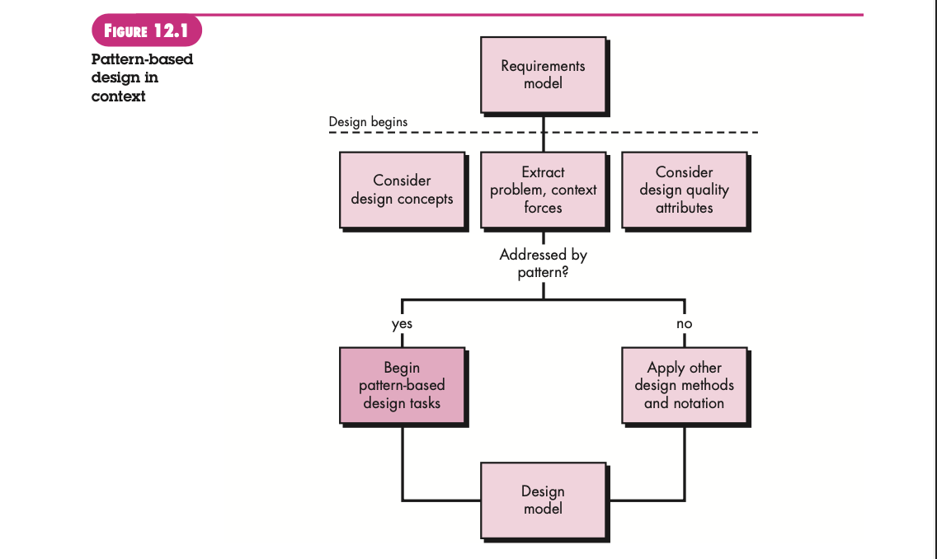

Slide 57
Thinking in Patterns
Shalloway and Trott [Sha05] suggest the following approach that enables a designer to think in patterns:
1. Be sure you understand the big picture—the context in which the software to be built resides. The requirements model should communicate this to you.
2. Examining the big picture, extract the patterns that are present at that level of abstraction.
3. Begin your design with ‘big picture’ patterns that establish a context or skeleton for further design work.
4. “Work inward from the context” [Sha05] looking for patterns at lower levels of abstraction that contribute to the design solution.
5. Repeat steps 1 to 4 until the complete design is fleshed out.
6. Refine the design by adapting each pattern to the specifics of the software you’re trying to build.

Slide 58
Design Task
The following design tasks are applied when a pattern-based design philosophy is used:
Examine the requirements model and develop a problem hierarchy.
Determine if a reliable pattern language has been developed for the problem domain.
Beginning with a broad problem, determine whether one or more architectural patterns are available for it.
Using the collaborations provided for the architectural pattern, examine subsystem or component level problems and search for appropriate patterns to address them.
Repeat steps 2 through 5 until all broad problems have been addressed.

Slide 59
6. If user interface design problems have been isolated (this is almost always the case), search the many user interface design pattern repositories for appropriate patterns.
7. Regardless of its level of abstraction, if a pattern language and/or patterns repository or individual pattern shows promise, compare the problem to be solved against the existing pattern(s) presented.
8. Be certain to refine the design as it is derived from patterns using design quality criteria as a guide.

Slide 60
Building a Pattern-Organizing Table
A pattern-organizing table can be implemented as a spreadsheet model using the form shown in the figure.
An abbreviated list of problem statements, organized by data/content, architecture, component-level, and user interface issues, is presented in the left-hand (shaded) column.
Four pattern types database, application,implementation, and infrastructure are listed across the top row.
The names of candidate patterns are noted in the cells of the table.

Slide 61
Pattern Organizing Table
Example: every house (and every architectural style for houses) employs a Kitchen pattern.
The Kitchen pattern and patterns it collaborates with address problems associated with the storage and preparation of food, the tools required to accomplish these tasks, and rules for placement of these tools relative to workflow in the room.
In addition, the pattern might address problems associated with counter tops, lighting, wall switches, a central island, flooring, and so on.
Obviously, there is more than a single design for a kitchen, often dictated by the context and system of forces. But every design can be conceived within the context of the ‘solution’ suggested by the Kitchen pattern.

Slide 62
Common Design Mistakes
Not enough time has been spent to understand the underlying problem, its context and forces, and as a consequence, you select a pattern that looks right, but is inappropriate for the solution required.
Once the wrong pattern is selected, you refuse to see your error and force fit the pattern.
In other cases, the problem has forces that are not considered by the pattern you’ve chosen, resulting in a poor or erroneous fit.
Sometimes a pattern is applied too literally and the required adaptations for your problem space are not implemented.

Slide 63
Patterns Repositories
There are many sources for design patterns available on the Web. Some patterns can be obtained from individually published pattern languages, while others are available as part of a patterns portal or patterns repository.
A list of patterns repositories is presented in the sidebar near Section 12.3 (from Refeference book)

Slide 64
Component-Level Patterns
Component-level design patterns provide a proven solution that addresses one or more sub-problems extracted from the requirement model.
In many cases, design patterns of this type focus on some functional element of a system.
For example, the SafeHomeAssured.com application must address the following design sub-problem: How can we get product specifications and related information for any SafeHome device?

Slide 65
Having enunciated the sub-problem that must be solved, consider context and the system of forces that affect the solution.
Examining the appropriate requirements model use case, the specification for a SafeHome device (e.g., a security sensor or camera) is used for informational purposes by the consumer.
However, other information that is related to the specification (e.g., pricing) may be used when e-commerce functionality is selected.
The solution to the sub-problem involves a search. Since searching is a very common problem, it should come as no surprise that there are many search-related patterns.
See Section 12.4

Slide 66
User Interface (UI) Patterns
Whole UI. Provide design guidance for top-level structure and navigation throughout the entire interface.
Page layout. Address the general organization of pages (for Websites) or distinct screen displays (for interactive applications)
Forms and input. Consider a variety of design techniques for completing form-level input.
Tables. Provide design guidance for creating and manipulating tabular data of all kinds.
Direct data manipulation. Address data editing, modification, and transformation.
Navigation. Assist the user in navigating through hierarchical menus, Web pages, and interactive display screens.
Searching. Enable content-specific searches through information maintained within a Web site or contained by persistent data stores that are accessible via an interactive application.
Page elements. Implement specific elements of a Web page or display screen.
E-commerce. Specific to Web sites, these patterns implement recurring elements of e-commerce applications.

Slide 67
WebApp Patterns
Information architecture patterns relate to the overall structure of the information space, and the ways in which users will interact with the information.
Navigation patterns define navigation link structures, such as hierarchies, rings, tours, and so on.
Interaction patterns contribute to the design of the user interface. Patterns in this category address how the interface informs the user of the consequences of a specific action; how a user expands content based on usage context and user desires; how to best describe the destination that is implied by a link; how to inform the user about the status of an on-going interaction, and interface related issues.
Presentation patterns assist in the presentation of content as it is presented to the user via the interface. Patterns in this category address how to organize user interface control functions for better usability; how to show the relationship between an interface action and the content objects it affects, and how to establish effective content hierarchies.
Functional patterns define the workflows, behaviors, processing, communications, and other algorithmic elements within a WebApp.

Slide 68
Note: chapter 8, Chapter 9, Chapter 12 from Reference book
THANK YOU

